Slide 1
Land Acknowledgement
We acknowledge that the land on which we gather is the traditional territory of many nations. We recognize the longstanding relationships between the Indigenous peoples of this place, including the Anishinaabe, Haudenosaunee, Huron-Wendat, and Métis peoples.
This land, also referred to as Tkaronto, has been a meeting place for many Indigenous nations long before the arrival of settlers, and it continues to be home to diverse Indigenous communities today. We are grateful to have the opportunity to live and work on this land.
We commit to ongoing learning, listening, and supporting the Indigenous communities as we move towards reconciliation and collective healing.

Slide 2
FM Cappuccino Hour
March 26, 2025
Are You Happy with Your Current Job?
Hosted by : Marcia O’Connor, President AMFM Consulting
Note: Recorded Session

Slide 3
Table of Contents
Welcome and Introductions
Key Criteria - Stay or Go?
Discussion & Reflection
Next Cappuccino Hour
The session will be recorded
Key Criteria – Successful Employee/Employer Relationship
Take Action

Slide 4
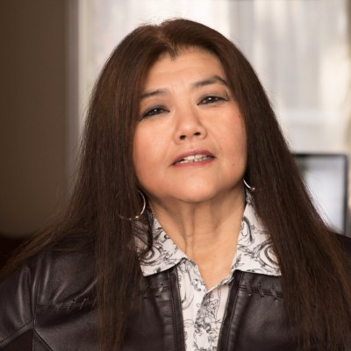
Introductions
Marcia O’Connor
President and Founder,
AM FM Consulting Group Inc.

Slide 5
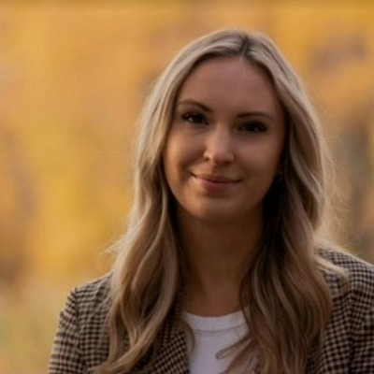
Special Guest
Brooklyn Thomas
Recruiter/Early Careers Specialist at JLL LinkedIn

Slide 6
Let's chat

Slide 7
Cappuccino Hour is a casual platform for Facility Managers to gather, converse, and delve into hot topics of interest.
Great way to keep connected!
It's a great opportunity to network with like-minded peers, expanding professional connections.
​
Cappuccino Hour explores trending topics, share best practices, and taps into the expertise of subject matter professionals, to help you explore other options.
​

Slide 8
Are you happy in your current job, or is it time to explore new opportunities?

Slide 9
Instructions
Go to www.menti.com
Or
Scan QR code
Code: 5848 8207

Slide 10
I Love My Job
yes
no

Slide 11
How Long Have You Had Your Current Job?
less than 12 months
1-3 years
4-10 years
10+ years
Notes:
Multiple choice:
0-3 years
3+ - 5 years
5+ - 10 years
10+ years

Slide 12
How Does the Thought of Leaving Your Current Job Make You Feel Emotionally?
Ecstatic
Very Sad
So-So
Notes:
Word map

Slide 13
What Do You Believe to Be Your Greatest Challenge in Your Current Job?
Notes:
Multiple choice
High Expectations and Low Recognition
Budget Constraints
Rapid Technological Advancements
Regulatory Compliance
Unpredictable Workloads
Interpersonal Challenges
Inadequate Support
24/7 Responsibility

Slide 14
Key Criteria for Successful Employee - Employer Relationship
Improved employee retention
Increased productivity
Effective communication
Employee well-being
Corporate Culture and Values
Notes:
Enhanced job satisfaction: Positive relationships at work can significantly boost job satisfaction. When employees feel valued, respected, and appreciated, they are more likely to enjoy their work and be motivated to perform at their best.
Improved employee retention: Organizations with strong employer-employee relationships tend to have lower turnover rates. Employees who feel connected to their workplace and colleagues are less likely to seek opportunities elsewhere.
Increased productivity: Employees with good relationships with their supervisors and coworkers are often more engaged and motivated to excel in their roles. This heightened commitment leads to increased productivity and better overall performance.
Effective communication: Good relationships facilitate open and effective communication. When employees feel comfortable expressing their ideas, concerns, and feedback, it can lead to better problem-solving, innovation, and collaboration within the organization.
Conflict resolution: In any workplace, conflicts can arise. However, conflicts are more likely to be resolved constructively in an environment of trust and respect. Healthy employer-employee relationships make it easier to address and resolve issues in a way that benefits both parties.
Employee well-being: A positive work environment created through good relationships can positively impact employees’ mental and emotional well-being. It can reduce stress, anxiety, and burnout, promoting better overall health.

Slide 15
Key Criteria | Yes (Stay) | No (Go)
Culture Do you have positive healthy relationships with people you work with?
Career Advancements Are there opportunities to advance your role?
Wage Financially, are you satisfied?
Work-Life Balance Do you resonate with the lifestyle that comes with your position/ this industry?
Your Alternatives Do you need this job? or are there alternatives?
Key Criteria - Stay or Go?
Key Criteria | Yes (Stay) | No (Go)
Interest Do you feel interested in what you do?
Ability to Impact Do you feel like you get to make a difference, be influential?
Job Security Do you feel secure in your role/company?
Professional Growth Do you feel like your skills are getting used, developed and/or strengthened?
Notes:
change into checklist

Slide 16
What Criteria do You Value Most?

Slide 17
Take Action – What Can You do if You Plan to Stay?
Know your role and set boundaries: knowing what requests are outside your scope of work will allow you to articulate your boundaries clearly to others, which helps prevent misunderstandings | Communicate your concerns to upper management and ask for support when needed | Professional development e.g. Use of Advanced Technology for efficiency | Be proactive: Anticipate problems/emergencies. Knowledge on things that can (and will) go wrong allows you to navigate emergencies easier when you are prepared

Slide 18
Take Action - What to do if You Plan to Go?
Reflect on your accomplishments. Refine your resume with personal accomplishments and skills. Practice an “elevator pitch” for yourself. | Dedicate time to enhance your skills or further your education. | Build a professional network or communicate with your established network. | Define your career objectives. Outline what you want from your next career that you’ve been missing in your current role.

Slide 19
Are you happy in your current job, or is it time to explore new opportunities?
Notes:
Multiple Choice
Happy
Ready to explore
unsure

Slide 20
JLL Career Advice
How to apply
JLL Assessment Process
Contact:
Brooklyn Thomas
Brooklyn.Ashwell@jll.com
linkedin

Slide 21
Let's Chat some more

Slide 22
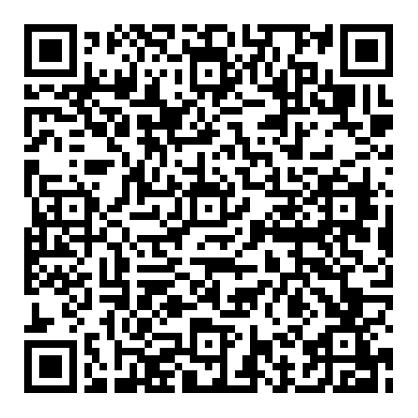
Next Cappuccino Hour Event
Learn innovative strategies to effectively secure critical C-Suite support, ensuring a vibrant and safe built environment.
Date: April 30th, 2025
Time: 6:00 PM to 7:00 PM EST.
Sign-up Link:

Slide 23
Let’s Share
Topic | Topic | Date and Time | Link | Description
IFMA (Canada) | U.S. Tariff - Webinar Part 3: What Plans Are FMs Making to Ease and Combat the U.S. Tariffs? | April 30, 3-4 pm EST | LInk to follow | Save the date
FM Student Alumni Event |  | Wednesday June 11, 2024 | Link to follow | In Person Event. Save the date
University of Toronto School of Continuing Studies: FM certificate Program |  | N/A | https://www.naturl.link/EJlHLW | Enhance your expertise in Facility Management (FM) with a recognized certificate program. Develop essential skills in operations, sustainability, and strategic planning to advance your career in FM.

Slide 24
Let’s Share
Topic | Topic | Date and Time | Link | Description
FM Connect Newsletter | Latest FM Trends Upcoming Events | N/A | Link | Stay informed and connected with FM Connect, your go-to source for the latest trends, updates, and insights in facility management.
PM Springfest |  | April 24, 2025 | Link | A fast-paced event for property managers and building owners featuring 230+ exhibitors, educational sessions, and networking opportunities.
IHM Annual Conference |  | May 6-7, 2025 | Link | A two-day conference in Oakville, Ontario, bringing together over 100 industry leaders to discuss emerging trends, share expertise, and address challenges in the housing industry.
PEMAC Lunch and Learn Webinar | Do You Have the Right Mindset to be a Professional AM? | Tuesday, May 6, 2025, 12:00 PM – 1:00 PM | Link | Learn how to excel as an Asset Manager by cultivating a mindset that blends strategic vision with analytical thinking and problem-solving skills to maintain and sustain your assets.

Slide 25
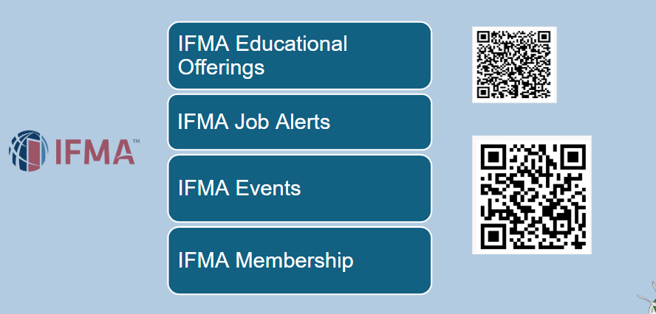

Slide 26
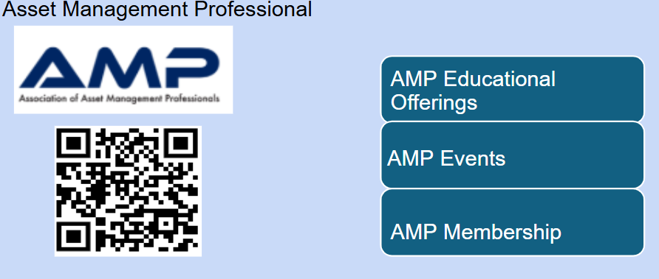
Link

Slide 27
Subscribe to the FM Connect Newsletter

Slide 28
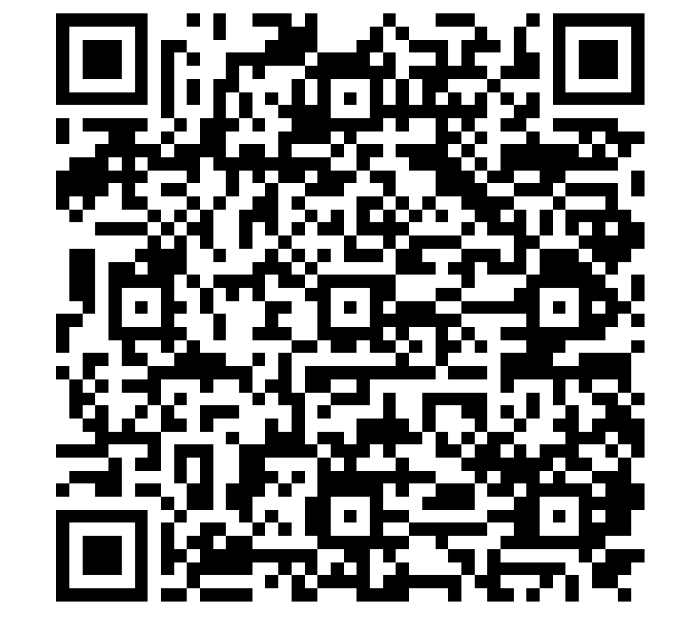
You've heard from us.
Chat with us!
Marcia ‘OConnor
(416)-433-3565
Marcia.Oconnor@amfmconsulting.com
www.amfmconsulting.com
LinkedIn:

Slide 29
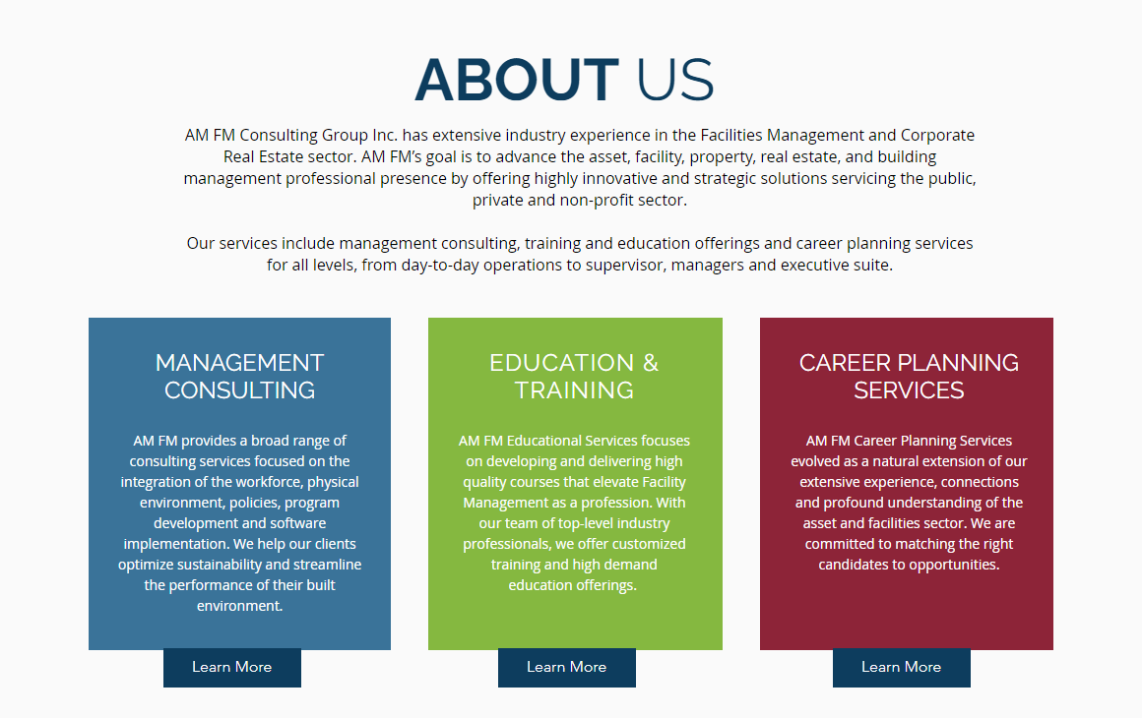
AM FM Company Profile
Pilicitajorge@gmail.com
Pilicitajorge@gmail.com
Pilicitajorge@gmail.com
AM FM Consulting Website

Slide 30
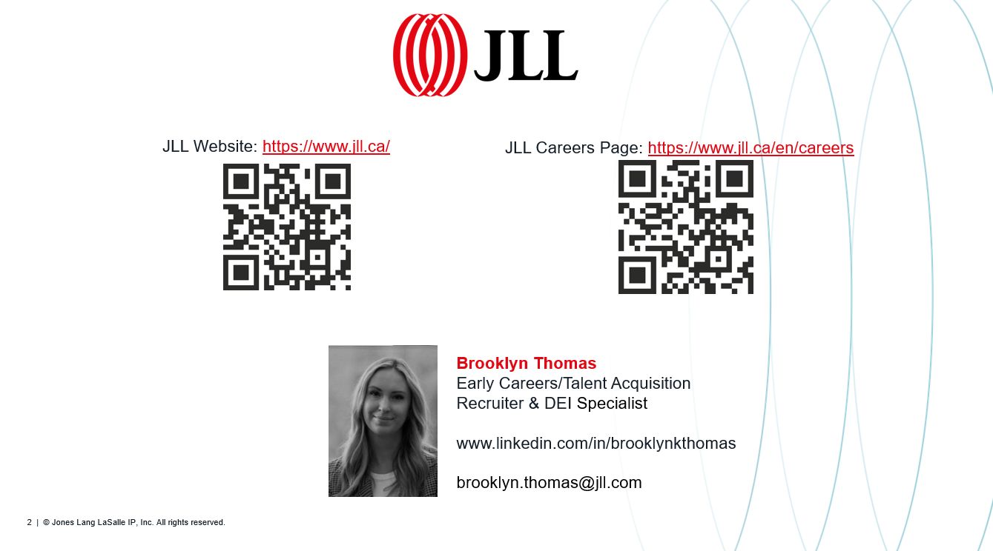

Slide 35
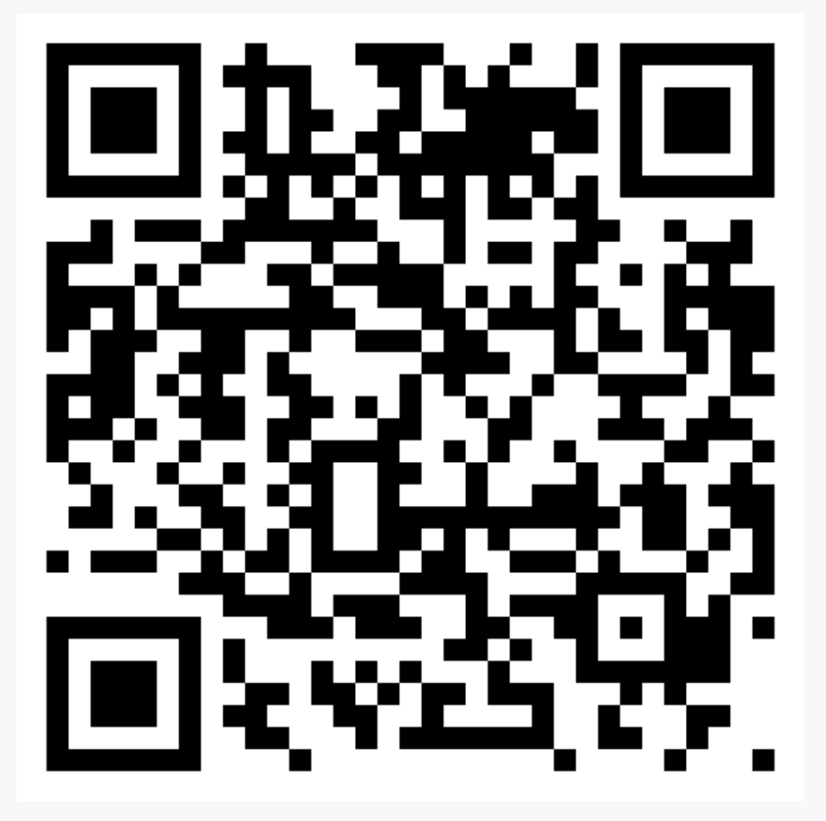
THANK YOU
Click the link below or scan the QR code to access a copy of this presentation and past presentations.
Link: Click here

